Slide 1

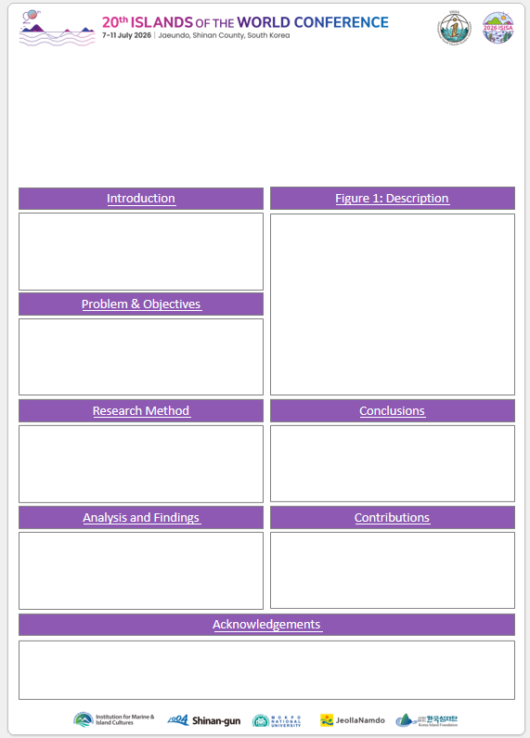
Poster Guidelines
01
Poster Template & Size
Please select one of the two sample templates and prepare your poster using the chosen format. Once completed, kindly save your poster as a PDF file.
The template samples are provided on the following slides. After selecting your preferred template, please delete the remaining pages.
All templates are set to A0 size (84.1cm x 118.9cm).
Template A
Template B
02
Readability Guidelines
Please use large fonts (minimum 24 pt) to ensure clarity.
Ensure sufficient contrast between the background and text.
Avoid dense paragraphs; instead, use figures, charts, and bullet points to highlight key messages.
Posters should be designed to be easily readable from a distance of 1.5 metres.
03
Preparation & Submission
Please prepare your poster in A0 size, referring to the provided template, and bring a printed copy with you to the venue.
In addition, kindly submit a PDF version of your poster to the Secretariat for reference by 23 June (two weeks prior to the event) via email.
Materials for attaching your poster (e.g. tape, scissors) will be provided on-site. Please arrive in advance between 13:00 and 18:00 on 6 July, or between 08:00 and 08:30 on 7 July, to set up your poster.
04
Enquiries
For any enquiries, please contact the Secretariat of the 20th Islands of the World Conference (2026 ISISA) at abstract@2026isisa.kr

